Slide 1
Presentation on OP AMP
Operational amplifier

Slide 2
Team Members
Fariha Anjum – 180041119
Farhan Ishmam – 180041120
Adnan Abdullah – 180041121
Md. Ashraful Islam – 180041122
Atiqur Rahman – 180041123
Farhan Saif - 180041124

Slide 3
Contents
Introduction to OP AMP
Mode of Operations
Applications of OP AMP
Gain of OP AMP
OFFSET Null Adjustments
Frequency Response (Noise)

Slide 4
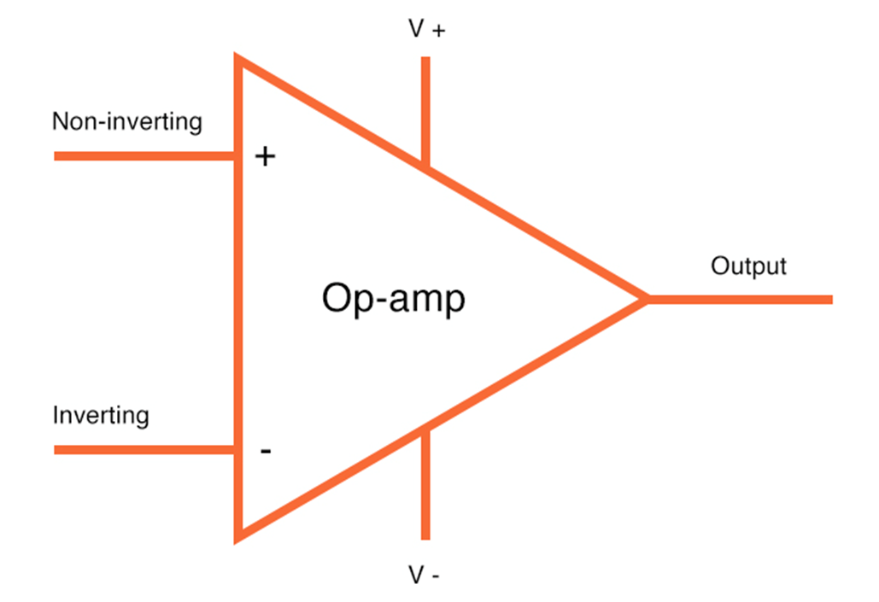
What is an Operational Amplifier?

Slide 5
Why it is called an Operational Amplifier?
Addition
Subtraction
Differentiation
Integration

Slide 6
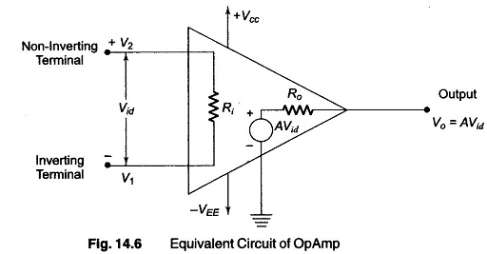

Basics of Operation
Operational Amplifier
equivalent circuit

Slide 7
Significance
1. Provides voltage amplitude changes
2. Oscillators, filter circuits etc.
3. Waveform converter
4. ADC and DAC

Slide 8
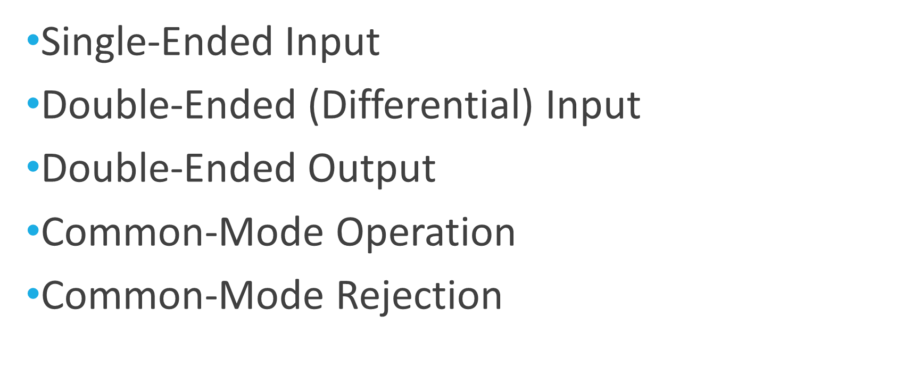
Modes of Operation

Slide 9
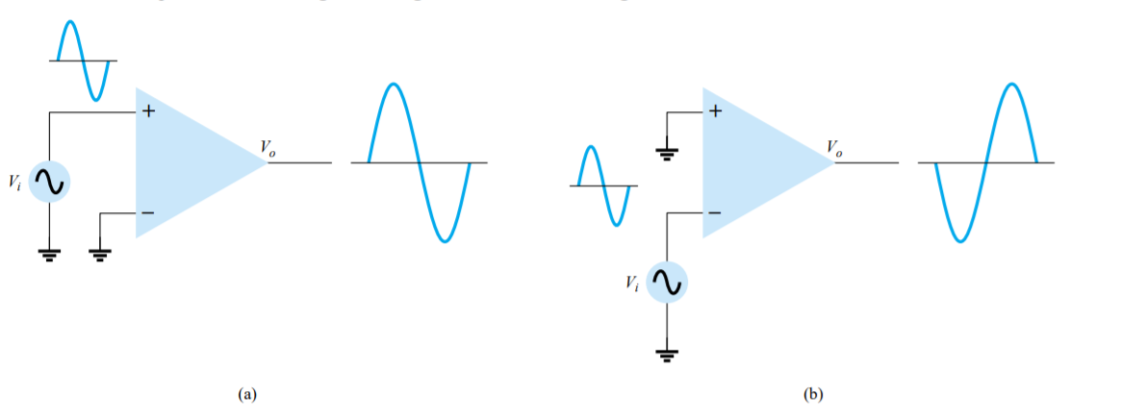
Single-Ended Input
Vo= A x Vi

Slide 10
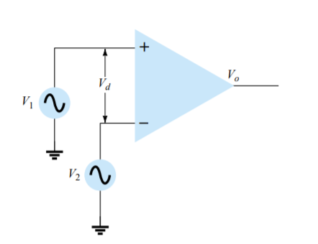
Double-Ended (Differential) Double Source Input
Vo= A x (V1-V2)
=> Vo= A x Vd

Slide 11
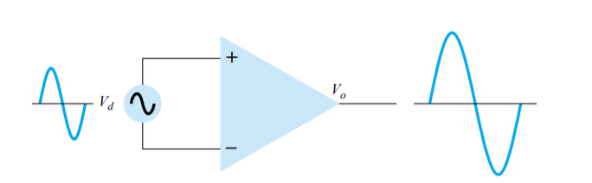
Double-Ended (Differential) Single Source Input
Vo= 2 x A x Vi

Slide 12
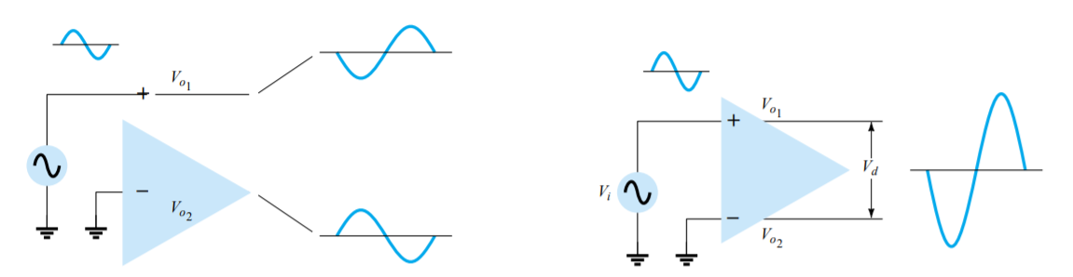
Double-Ended Output for Single Input
Vd = V01 – V02 = 2 x V01 = 2 x A x Vi

Slide 13
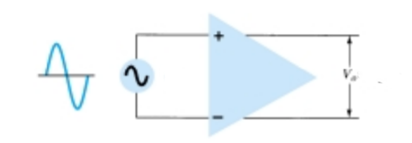
Double Ended Output for Differential Input
V01
Vi
V02
V01 = -2 x A x Vi
Vd = V02 - V01 = 4 x A x Vi
V02 = 2 x A x Vi

Slide 14
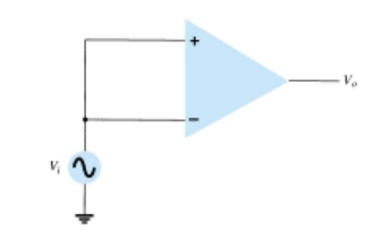
Common-Mode Operation
Vo= A x (Vi - Vi) = 0

Slide 15
Common-Mode Rejection
Differential Connection
- significantly amplifies opposite signal
- significantly reduces common signals to zero
Since noise (unwanted signal) is common to both input signals, it is significantly reduced. This feature is called Common Mode Rejection

Slide 16
OP AMP GAIN
Basic OP AMP Gain
Unity Gain
Constant Magnitude Gain

Slide 17
OP-AMP BASICS
An operational amplifier is a very high gain amplifier having very high input impedance (typically a few Mega ohms) and low output impedance (less than 100 ). The basic circuit is made using a difference amplifier having two inputs (plus and minus) and at least one output

Slide 18
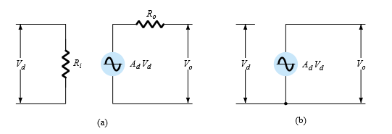
The ac equivalent circuit of the op-amp :

Slide 19
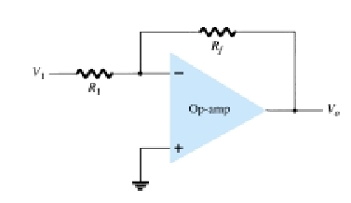
The basic circuit connection using an op-amp:

Slide 20
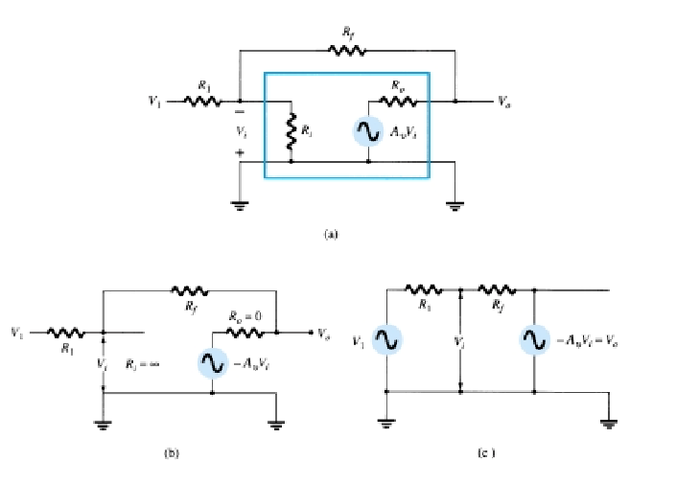
The op-amp replaced by its ac equivalent circuit:

Slide 21

Basic Op-Amp:

Slide 22

Unity Gain:

Slide 23
Constant Magnitude Gain:
If Rf is some multiple of R1, the overall amplifier gain is a constant. For example, if Rf =10R1, then,
VOLTAGE GAIN= - (Rf/R1)= - 10

Slide 24
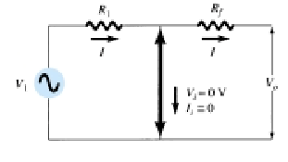
Virtual Ground:

Slide 25
Practical Op-Amp Circuits
Inverting Amplifier
Non-Inverting Amplifier
Summing Amplifier
Integrator
Differentiator

Slide 26

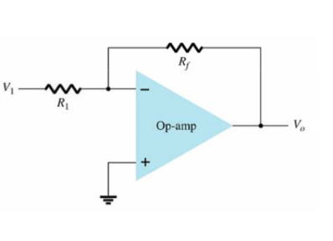


Slide 27

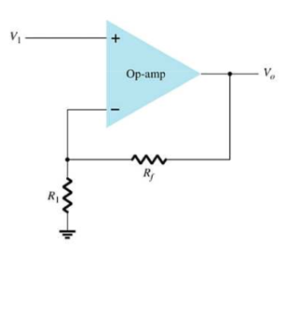


Slide 28

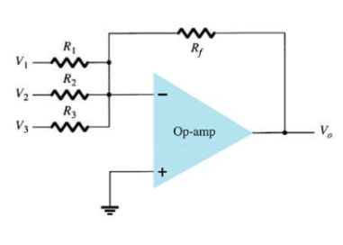


Slide 29

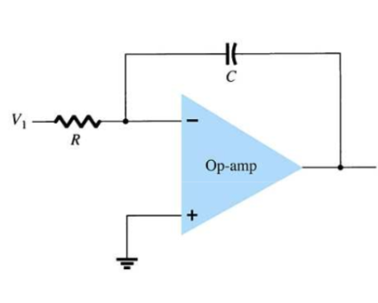


Slide 30

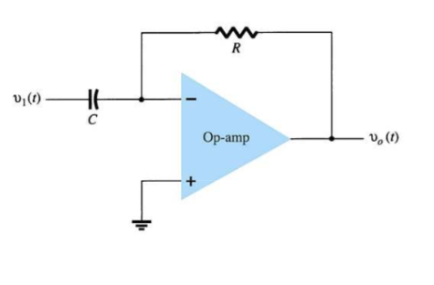


Slide 31
Offset Null Adjustment

Slide 32
What is Offset Null Adjustment?
If There is no voltage difference in the input then the output must be zero.But It is not really zero.There is some error.
To make the input zero we have to adjust the offset which is called Offset Null Adjustment.

Slide 33
Offset Null Adjustment
The Output offset mainly depend on two factors.
They are:
1. An input offset voltage
2.An offset current due to the difference in currents

Slide 34
Cause of Error Offset
1.Input offset
voltage
2.Input offset
Current
3. Input offset voltage and current
4. Input bias current

Slide 35
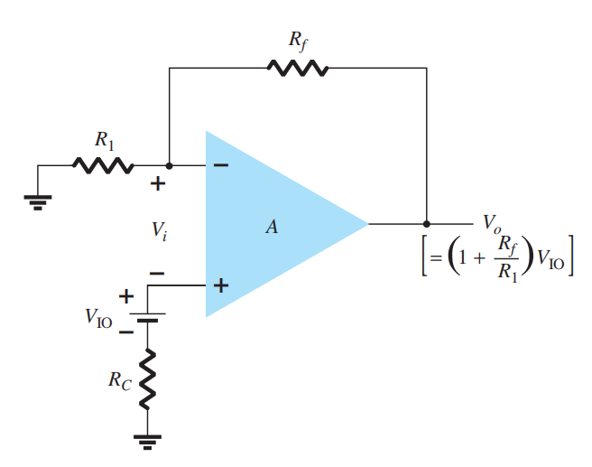
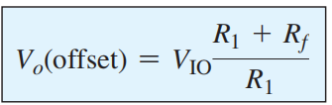
Input Voltage Offset

Slide 36
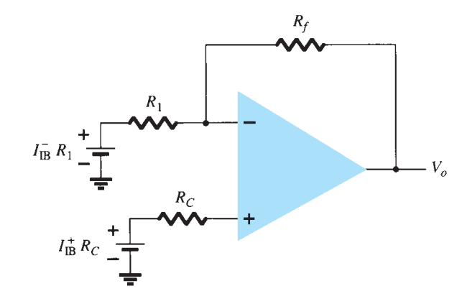

Input Current Offset

Slide 37
Total Offset Due to Voltage and Current

Slide 38
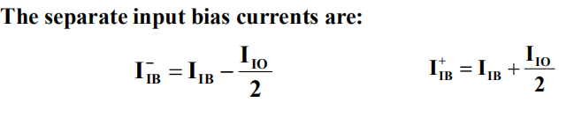
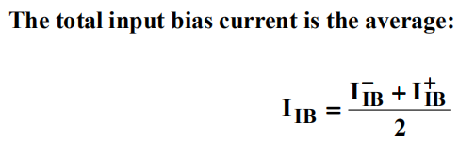
Input Bias Current (IIB)
A parameter that is related to input offset current (IIO) is called input bias current (IIB)

Slide 39
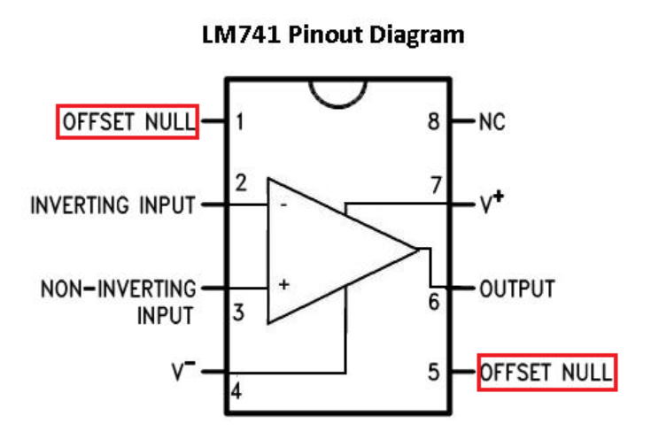
How To Solve This

Slide 40
Frequency Response

Slide 41
What is frequency response and what it does ?
Amplifiers are classified by frequency response.
WHY DOESN’T AN AMPLIFIER DESIGNED TO AMPLIFY SIGNAL OF 1000 Hz WORKS JUST AS WELL AS 1000MHz?
Cause components of the amplifier respond differently at different frequencies.
Capacitor and inductors in the circuit change their reactance in case of frequency changes.

Slide 42
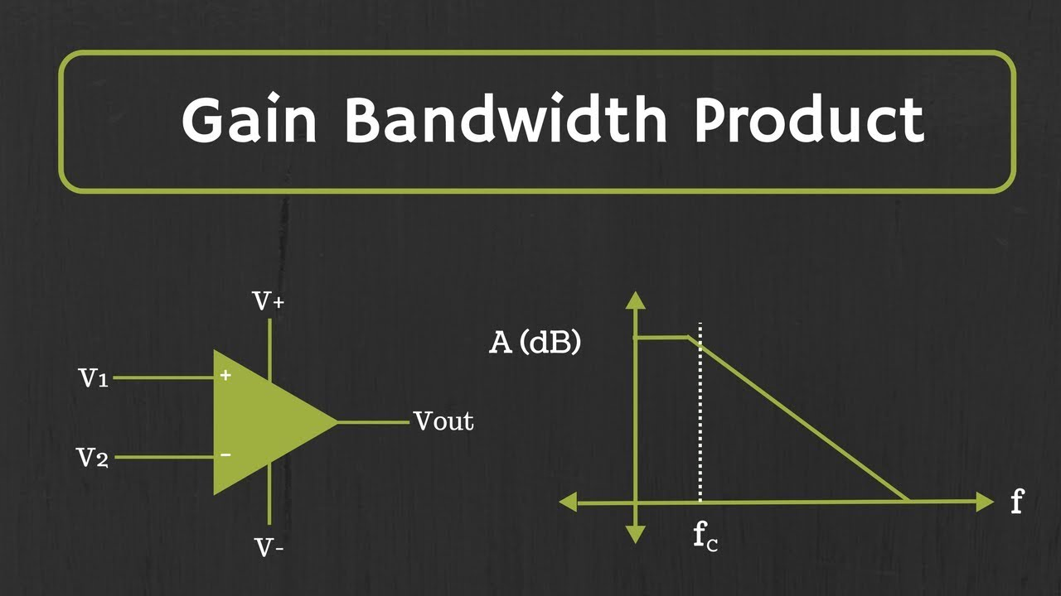
GAIN & BANDWITH
gain:: open loop ,it is operating at a highest possible gain with no feedback resistor.

Slide 43
SLEW RATE
SR is the max rate at which an op amp can change output without any distortion.
dv = voltage difference between in & out
dt = time difference
SR = dv/dt

Slide 44
MAX SIGNAL FREQUENCY
The slew rate determines the highest frequency of the op amp without distortion.
f = frequency
pi=3.1416
vp = peak voltage
f<=(SR)/2.pi.vp

Slide 45
NOISE
This noise is intrinsic to the amplifier or generated by associated passive components and then amplified. External noise is a system-level issue.
what are the sources of this noise?
Johnson (thermal) noise is generated by input and feedback resistors and the amplifier’s intrinsic voltage noise and current noise .
``

Slide 46
THE END

